Slide 1
Regression Analysis
Multiple Linear Regression
Nicoleta Serban, Ph.D.
Professor
School of Industrial and Systems Engineering
Regression Parameter Estimation:
Data Example

Slide 2

About This Lesson

Slide 3


Linear Regression: Example 1
Quantitative Predicting Variables:
X₁ = the amount (in hundreds of dollars) spent on advertising
X₂ = the total amount of bonuses paid
X₃ = the market share in each territory
X₄ = the largest competitor's sales
Qualitative Predicting Variable:
X₅ = a variable to indicate the region in which office is located (1 = south,
2 = west, 3 = midwest)
Response Variable:
Y = yearly sales (in thousands of dollars)
Sales
Advertisement

Slide 4
Example 1: Estimation & Interpretation
Fit a linear regression with all predictors. What are the estimated regression coefficients and the estimated regression line?
Interpret the coefficients. Compare the estimated coefficient for the advertisement expenditure variable under the conditional (full) model vs. the marginal (one predictor) model.
What change does the full regression model predict for yearly sales as the advertisement expenditure increases by an additional $1,000? Is this prediction different when compared to that from the simple linear model with the advertisement expenditure variable only?
What is the estimate of the error variance under the full model? Is it different from that under the simple linear regression model? Why?

Slide 5
Example 1: Estimation & Interpretation
meddcor = read.table("meddcor.txt", sep = "", header = FALSE)
colnames(meddcor) = c("sales", "advertising", "bonuses", "marketshare", "largestcomp", "region")
meddcor$region = as.factor(meddcor$region)
model = lm(sales ~ ., data = meddcor)
summary(model)
Coefficients:
---
Residual standard error: 55.57 on 18 degrees of freedom
Multiple R-squared: 0.9555, Adjusted R-squared: 0.9407
F-statistic: 64.42 on 6 and 18 DF, p-value: 3.466e-11
 | Estimate | Std. Error | t value | Pr(>|t|)
(Intercept) | 117.0200 | 192.9732 | 0.606 | 0.5518
advertising | 1.4092 | 0.2687 | 5.244 | 5.49e-05
bonuses | 1.0123 | 0.4641 | 2.181 | 0.0427
marketshare | 3.1548 | 2.9802 | 1.059 | 0.3038
largestcomp | -0.2354 | 0.2338 | -1.007 | 0.3275
region2 | 53.6285 | 34.7359 | 1.544 | 0.1400
region3 | 267.9569 | 47.5577 | 5.634 | 2.40e-05 ***

Slide 6

Example 1: Estimation & Interpretation
meddcor = read.table("meddcor.txt", sep = "", header = FALSE)
colnames(meddcor) = c("sales", "advertising", "bonuses", "marketshare", "largestcomp", "region")
meddcor$region = as.factor(meddcor$region)
model = lm(sales ~ ., data = meddcor)
summary(model)
Coefficients:
---
Residual standard error: 55.57 on 18 degrees of freedom
Multiple R-squared: 0.9555, Adjusted R-squared: 0.9407
F-statistic: 64.42 on 6 and 18 DF, p-value: 3.466e-11
Estimated Regression Coefficients
Conditional model:
$${\hat{β}}_{adv}=1.4092$$
The expected additional gain in sales in thousands for $100 additional expenditure in advertisement while holding all other fixed.
Marginal model:
$${\hat{β}}_{adv}=2.772$$
The expected additional gain in sales in thousands for $100 additional expenditure in advertisement not accounting for other predicting variables.
 | Estimate | Std. Error | t value | Pr(>|t|)
(Intercept) | 117.0200 | 192.9732 | 0.606 | 0.5518
advertising | 1.4092 | 0.2687 | 5.244 | 5.49e-05
bonuses | 1.0123 | 0.4641 | 2.181 | 0.0427
marketshare | 3.1548 | 2.9802 | 1.059 | 0.3038
largestcomp | -0.2354 | 0.2338 | -1.007 | 0.3275
region2 | 53.6285 | 34.7359 | 1.544 | 0.1400
region3 | 267.9569 | 47.5577 | 5.634 | 2.40e-05 ***

Slide 7
Example 1: Estimation & Interpretation
meddcor = read.table("meddcor.txt", sep = "", header = FALSE)
colnames(meddcor) = c("sales", "advertising", "bonuses", "marketshare", "largestcomp", "region")
meddcor$region = as.factor(meddcor$region)
model = lm(sales ~ ., data = meddcor)
summary(model)
Coefficients:
---
Residual standard error: 55.57 on 18 degrees of freedom
Multiple R-squared: 0.9555, Adjusted R-squared: 0.9407
F-statistic: 64.42 on 6 and 18 DF, p-value: 3.466e-11
c. An additional $1,000 in advertising expenditures results in $14,092 additional sales under the full model and $27,720 additional sales under the simple linear model.
Which is more meaningful? Because sales varies with other factors, the interpretation based on multiple regression is more meaningful.
d. Under the full model, the variance estimate is (55.57)². Under the simple linear model, the variance estimate was (101.4)².
Why? More variability in the response is explained when including multiple predicting variables versus only one.
 | Estimate | Std. Error | t value | Pr(>|t|)
(Intercept) | 117.0200 | 192.9732 | 0.606 | 0.5518
advertising | 1.4092 | 0.2687 | 5.244 | 5.49e-05
bonuses | 1.0123 | 0.4641 | 2.181 | 0.0427
marketshare | 3.1548 | 2.9802 | 1.059 | 0.3038
largestcomp | -0.2354 | 0.2338 | -1.007 | 0.3275
region2 | 53.6285 | 34.7359 | 1.544 | 0.1400
region3 | 267.9569 | 47.5577 | 5.634 | 2.40e-05 ***

Slide 8
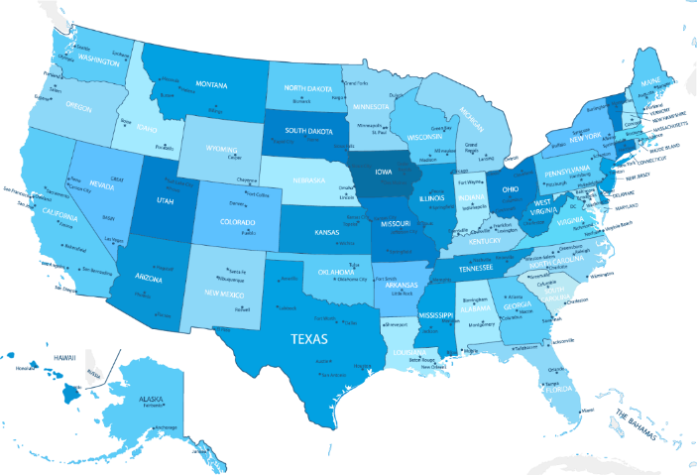
Linear Regression: Example 2
Explanatory Factors:
X₂ = Median income of families of test takers, in hundreds of dollars
X₃ = Average number of years that test takers had in social sciences, natural sciences, and humanities
X₄ = % of test takers who attended public schools
X₅ = State expenditure on secondary schools, in hundreds of dollars per student
Controlling Factors:
X₁ = % of total eligible students in the state who took the exam
X₆ = Median percentile of ranking of test takers within their secondary school classes
SAT Mean Score by State — Year 1982
790 (South Carolina) – 1088 (Iowa)

Slide 9

Summary

